Slide 1
Week 3 Updates Shapiro
By Evan Johns

Slide 2
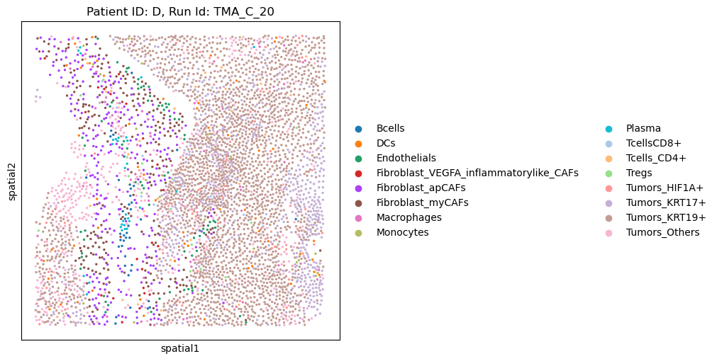
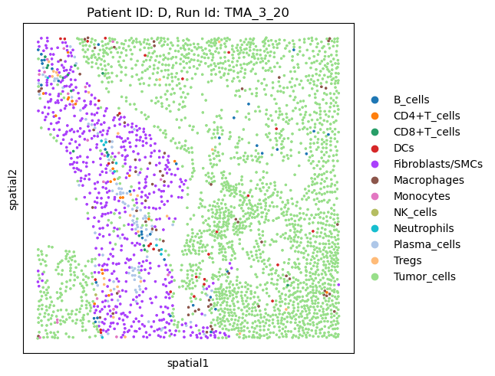
Mapping Protein to mRNA
mRNA
Protein
Updated to match RNA with the protein slides. Had to flip the Y coordinates so that they match
Matches are not 1-1 as expected and some are better than others.
Note the patient IDs in the metadata do not align
Week 2 Updates

Slide 3
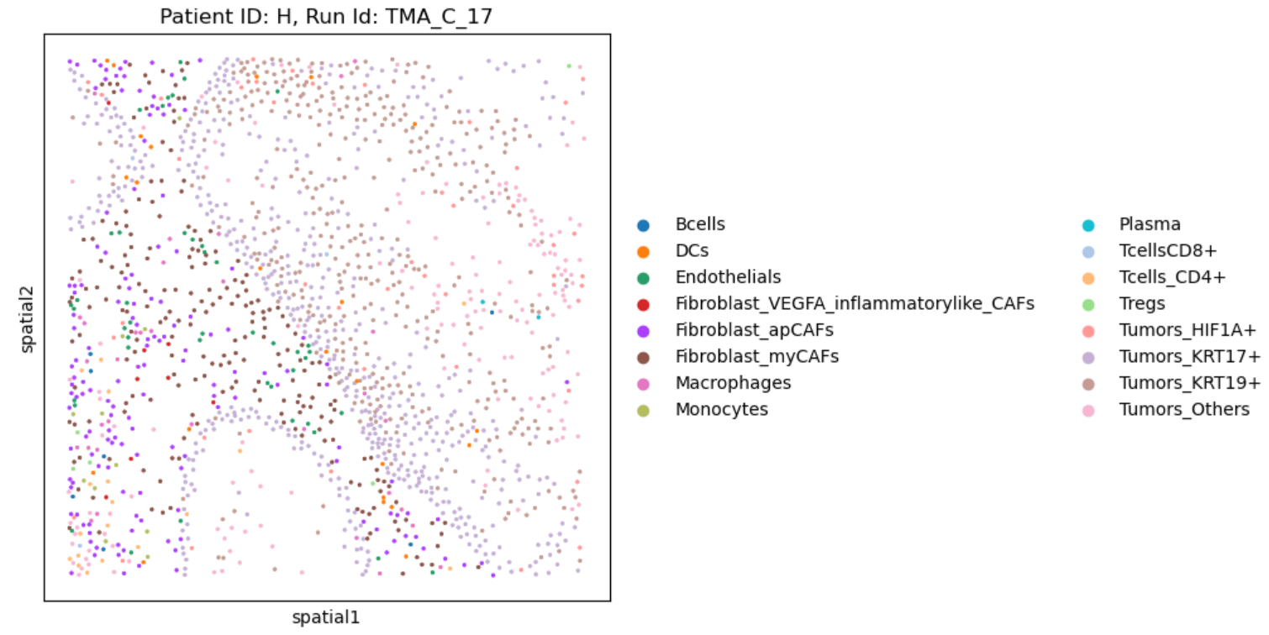
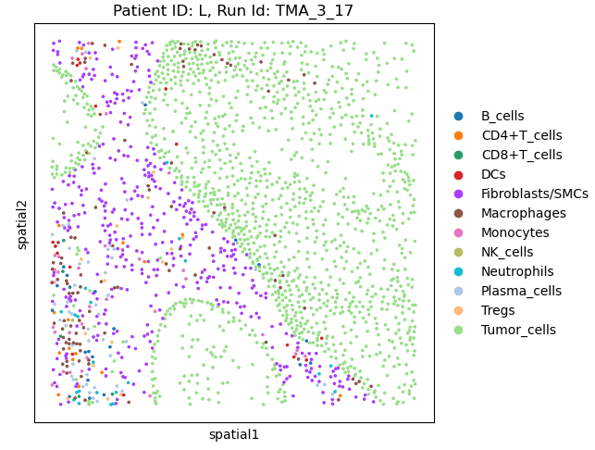
Mismatching Patient IDs between mRNA and Protein
Mismatching patient IDs H & L for the sample tissue sample. May cause issues analyzing the response status. Response status only listed in the RNA metadata

Slide 4
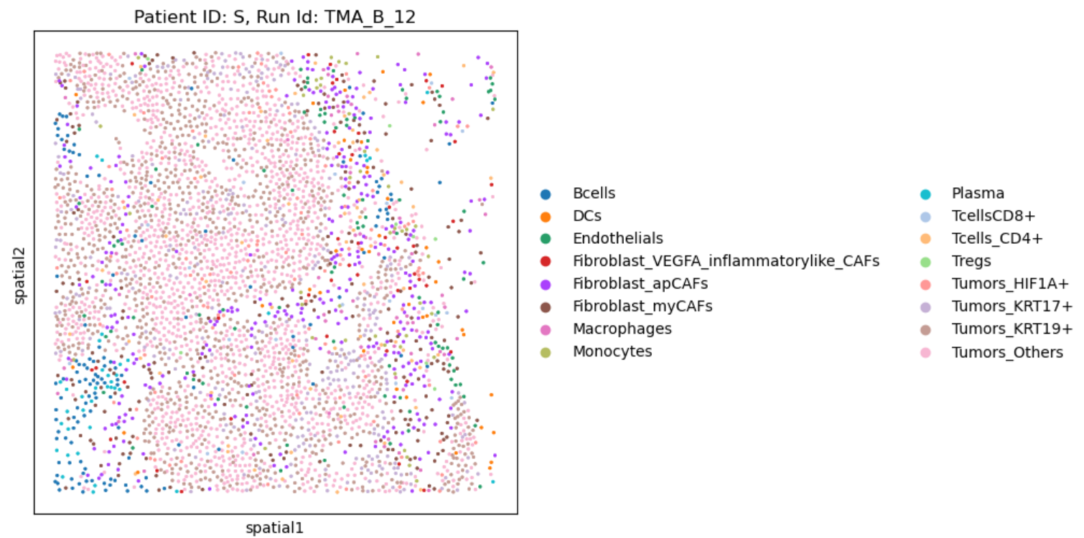
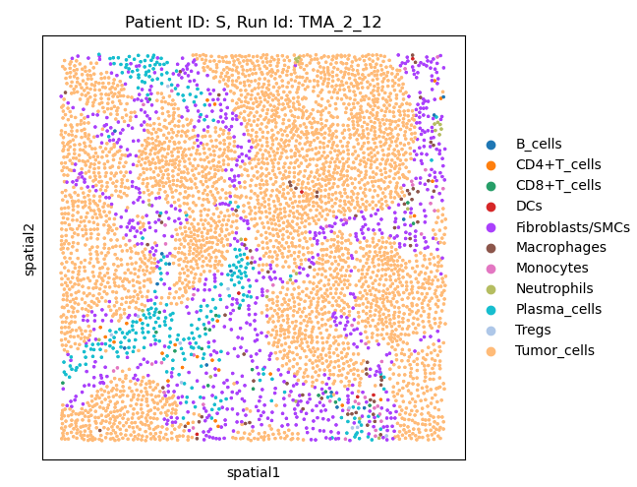
Some matches are poor
Most matches are recognizable, but some may be very difficult to map.
Recommend only trying to map a subset of the data.

Slide 5
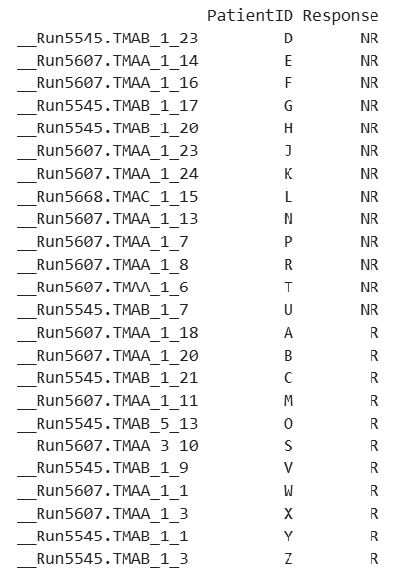
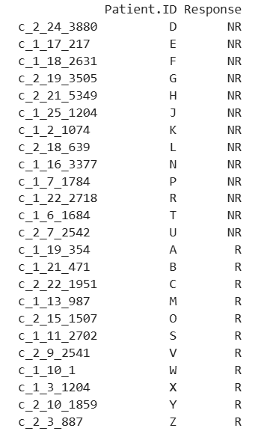
Response status is consistent
mRNA
Protein
The response status appears to be reliable, but the patient ID is not necessarily consistent.

Slide 6
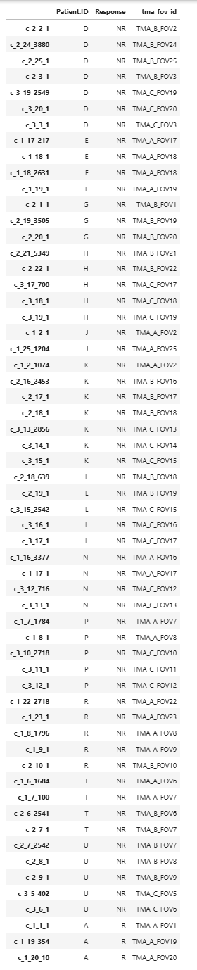
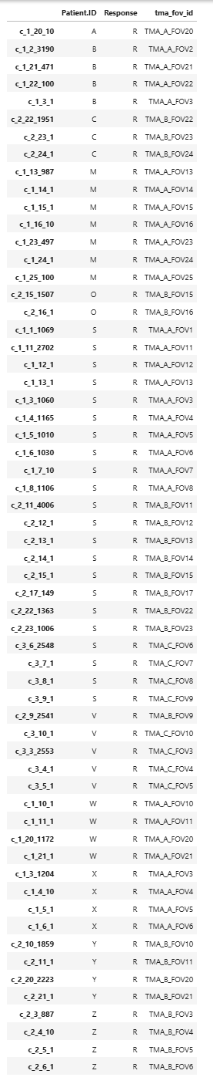
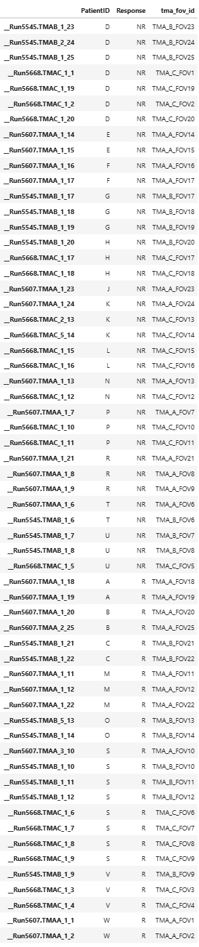
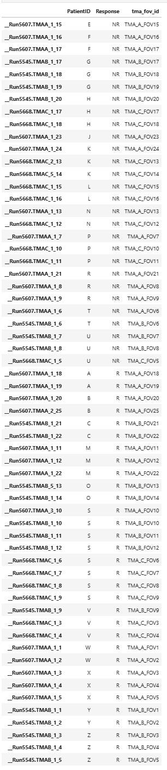
Protein
mRNA

Slide 7
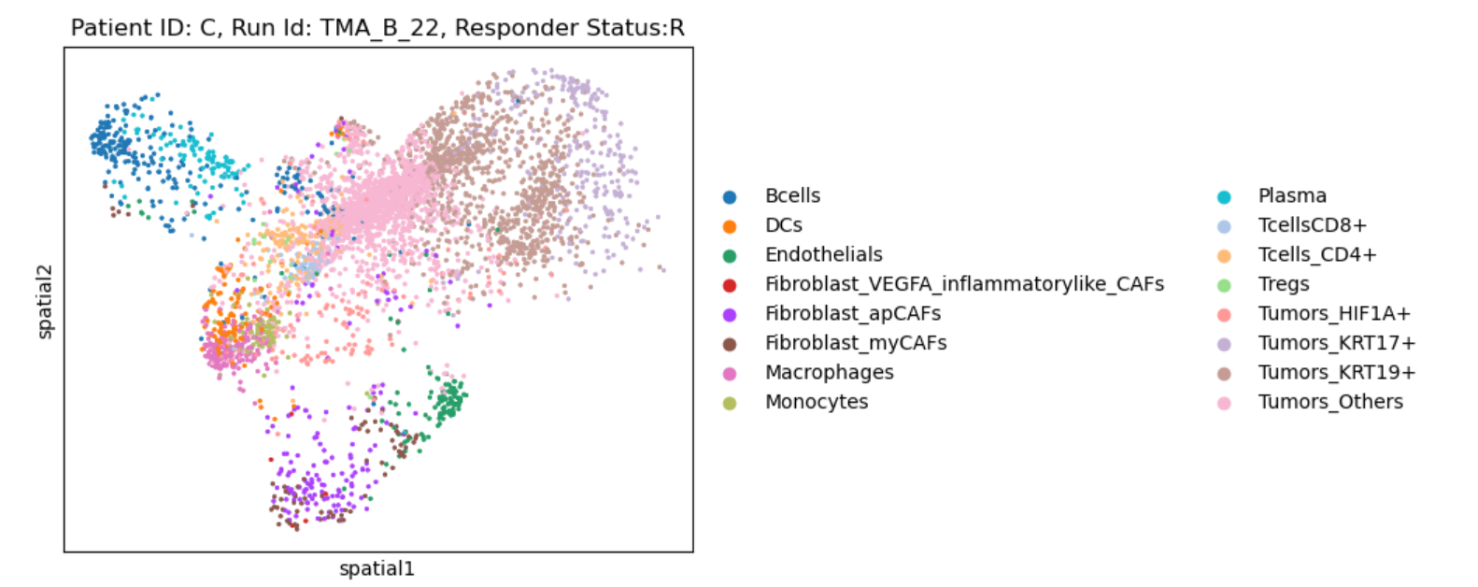
Umap Mappings for Cell Types in Python

Slide 8
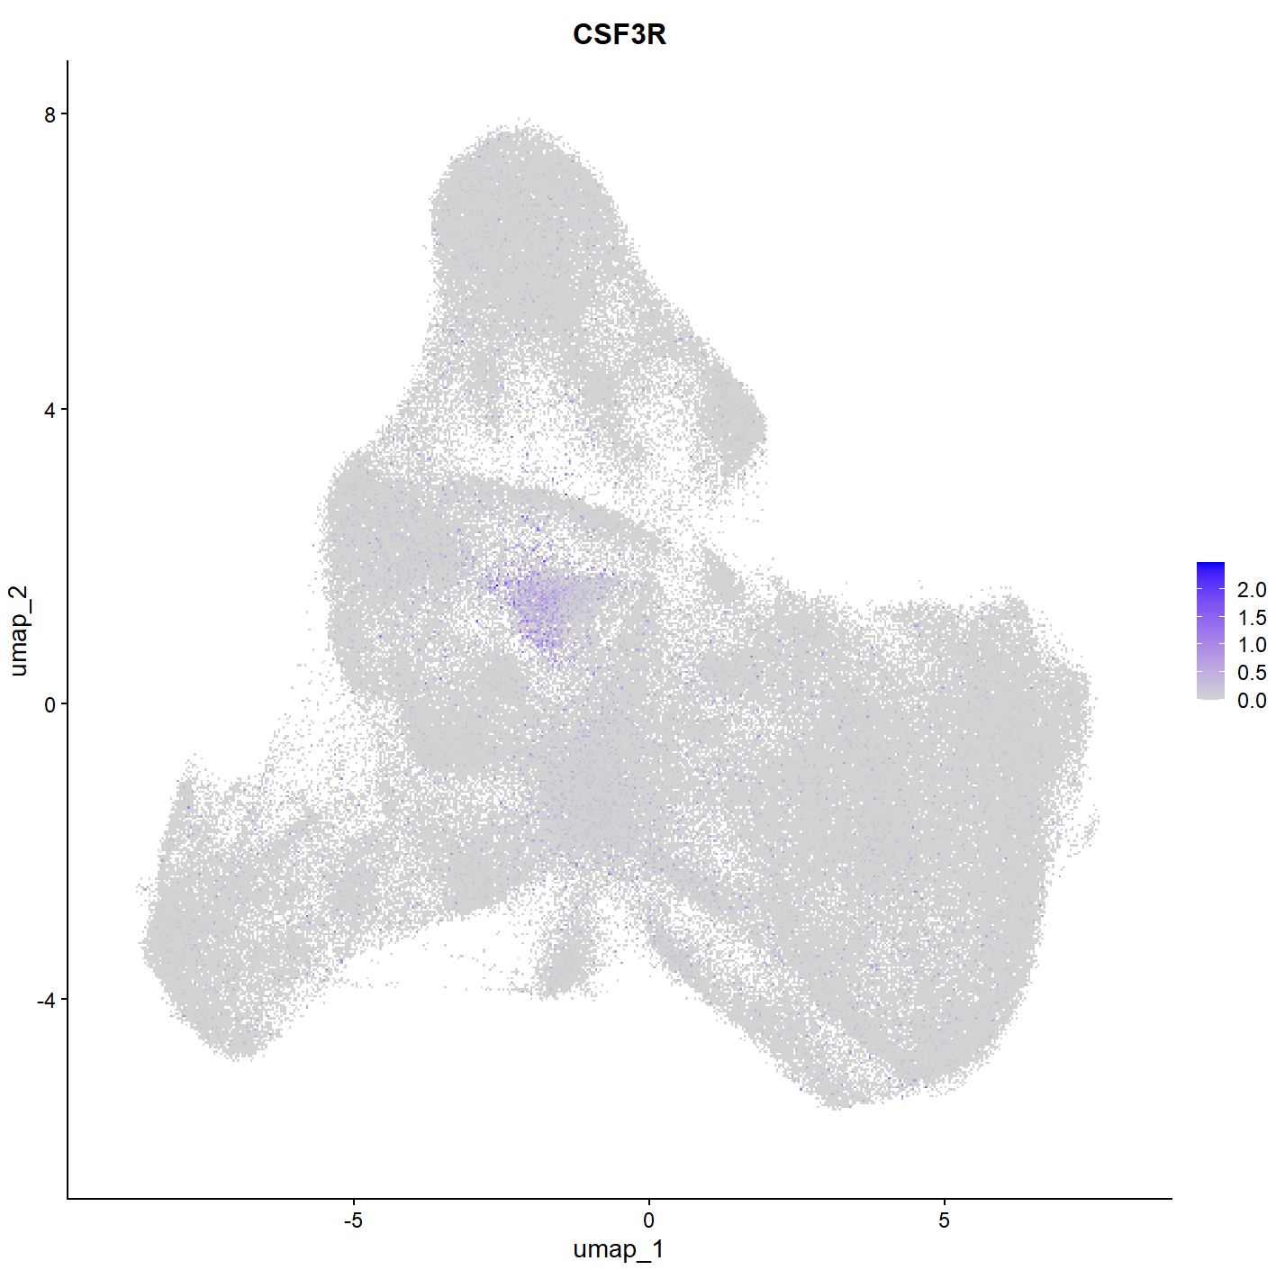
CSF3R Gene
Possible marker for PMN
Only expressed in small portion of cells. Not currently well definined
Future direction
Can we isolate cells with low overall expression and higher CSF3R expression
Other gene markers such as S100A8 and S100A9 may also be helpful

Slide 9
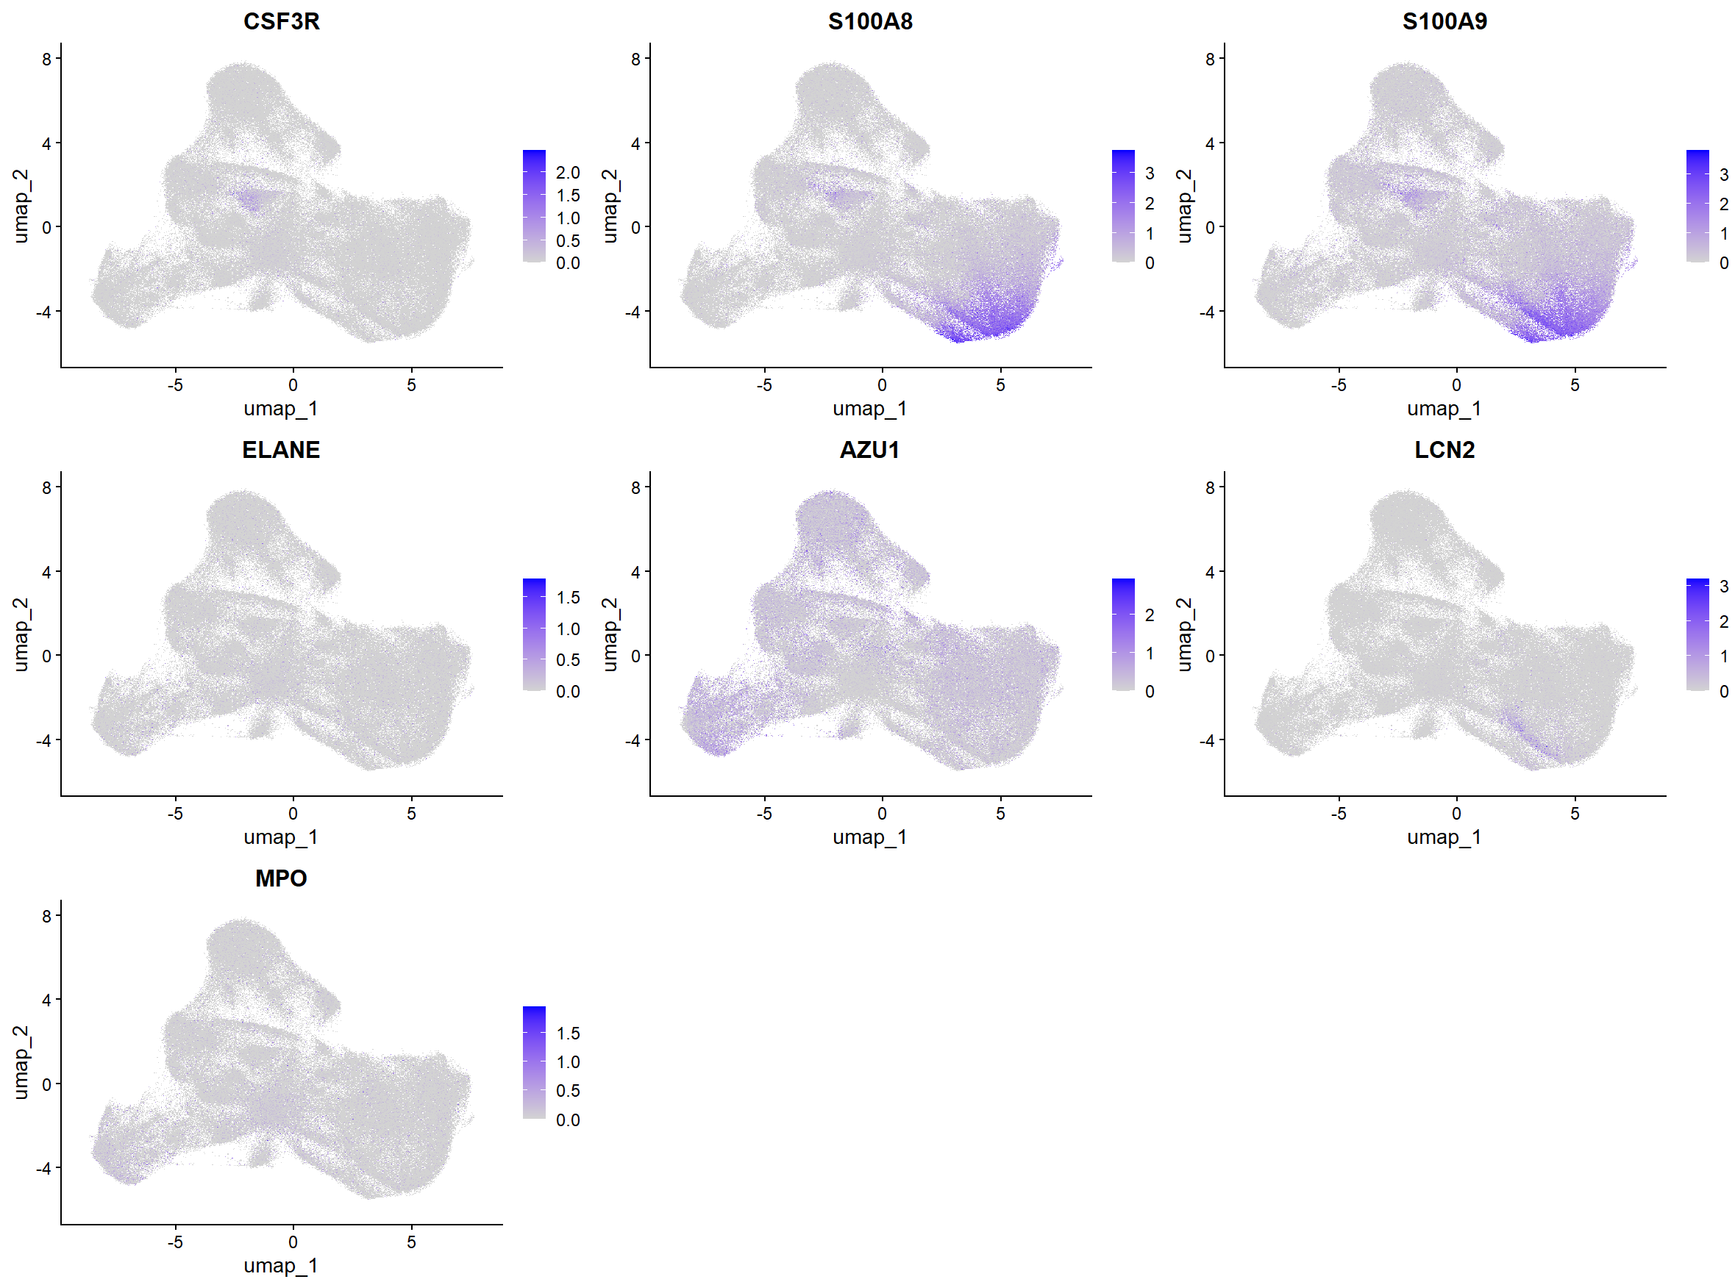
Other Genes

Slide 10
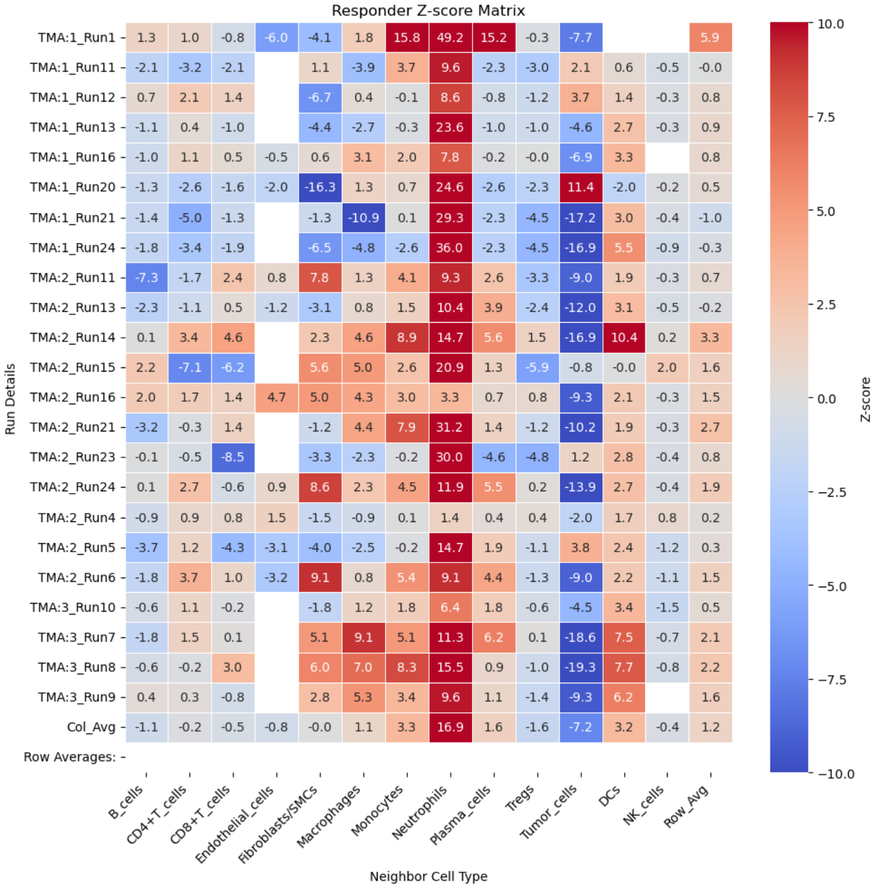
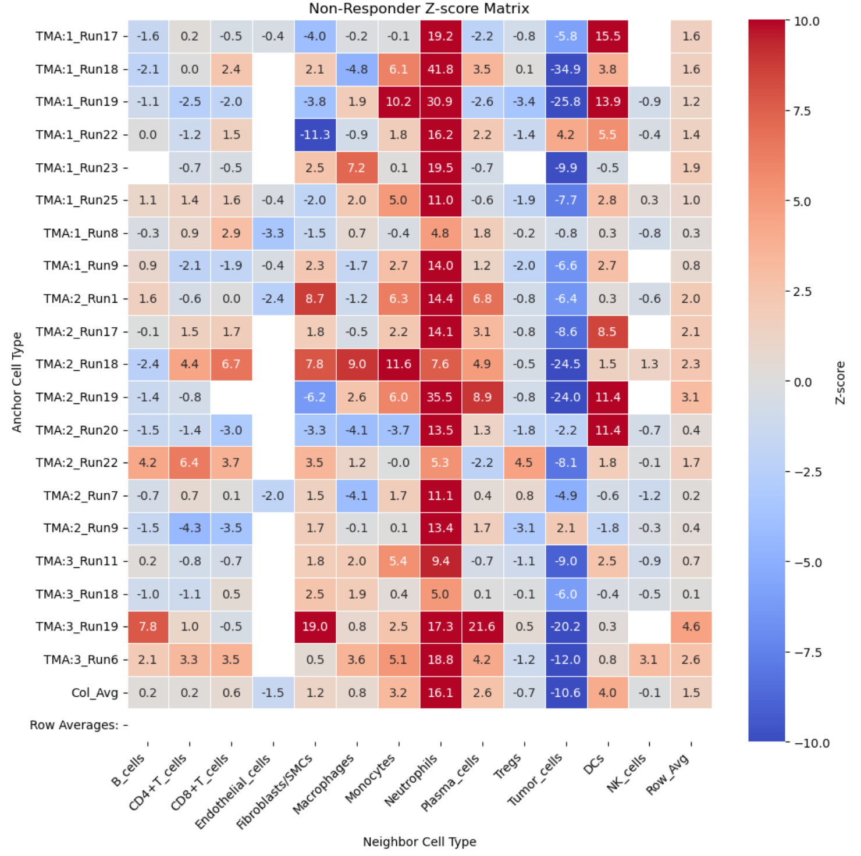
Protein Colocalization Analysis

Slide 11
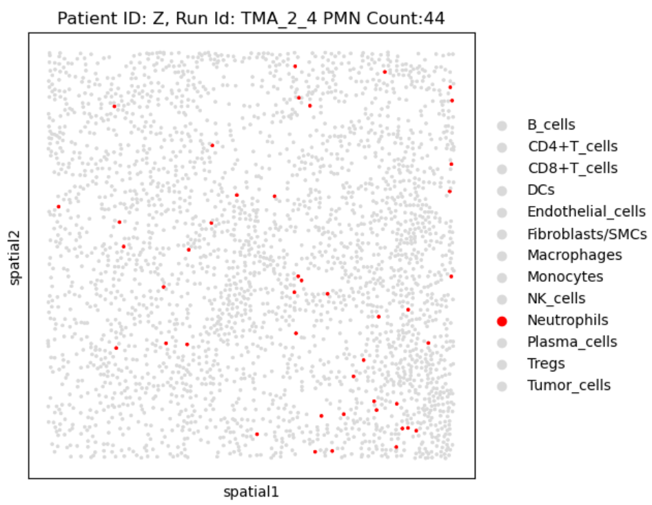
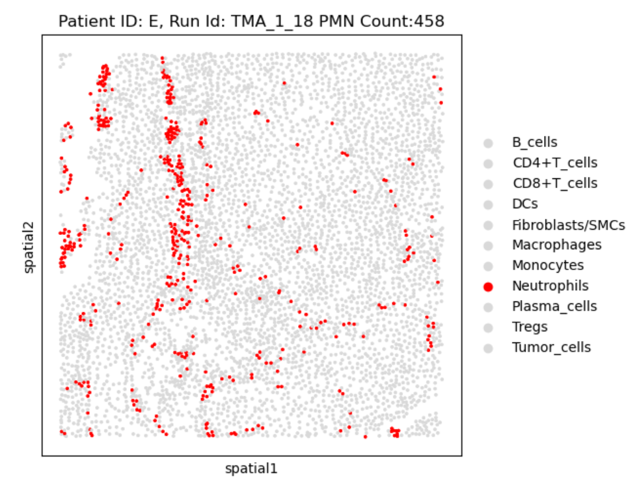
Colocalization Verification PMN-PMN interaction
Least Colocalization (z=1.4)
High Colocalization (z=41.8)

Slide 12
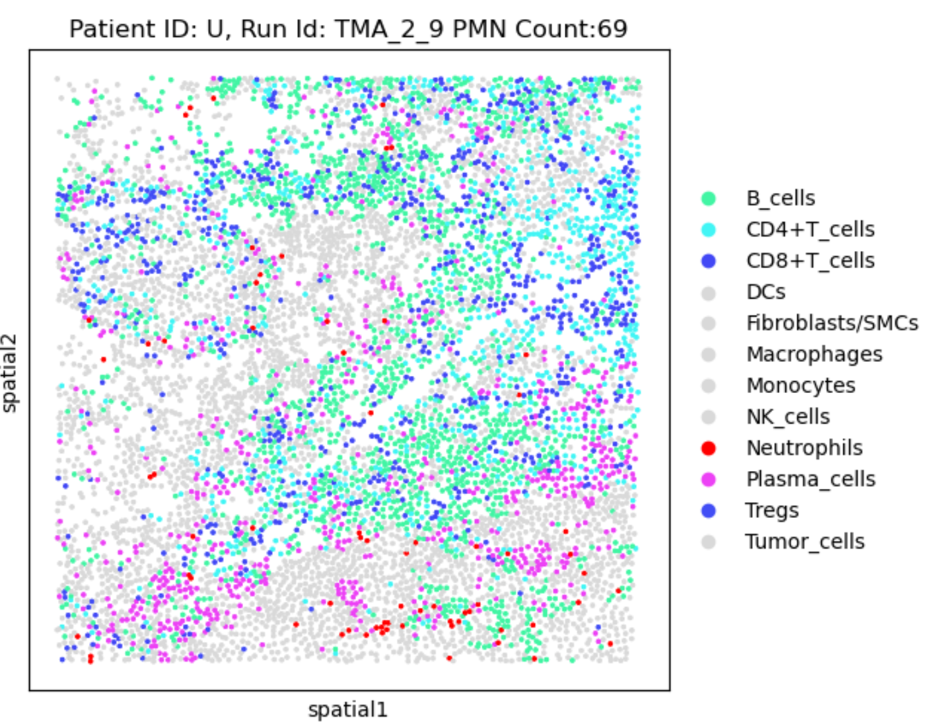
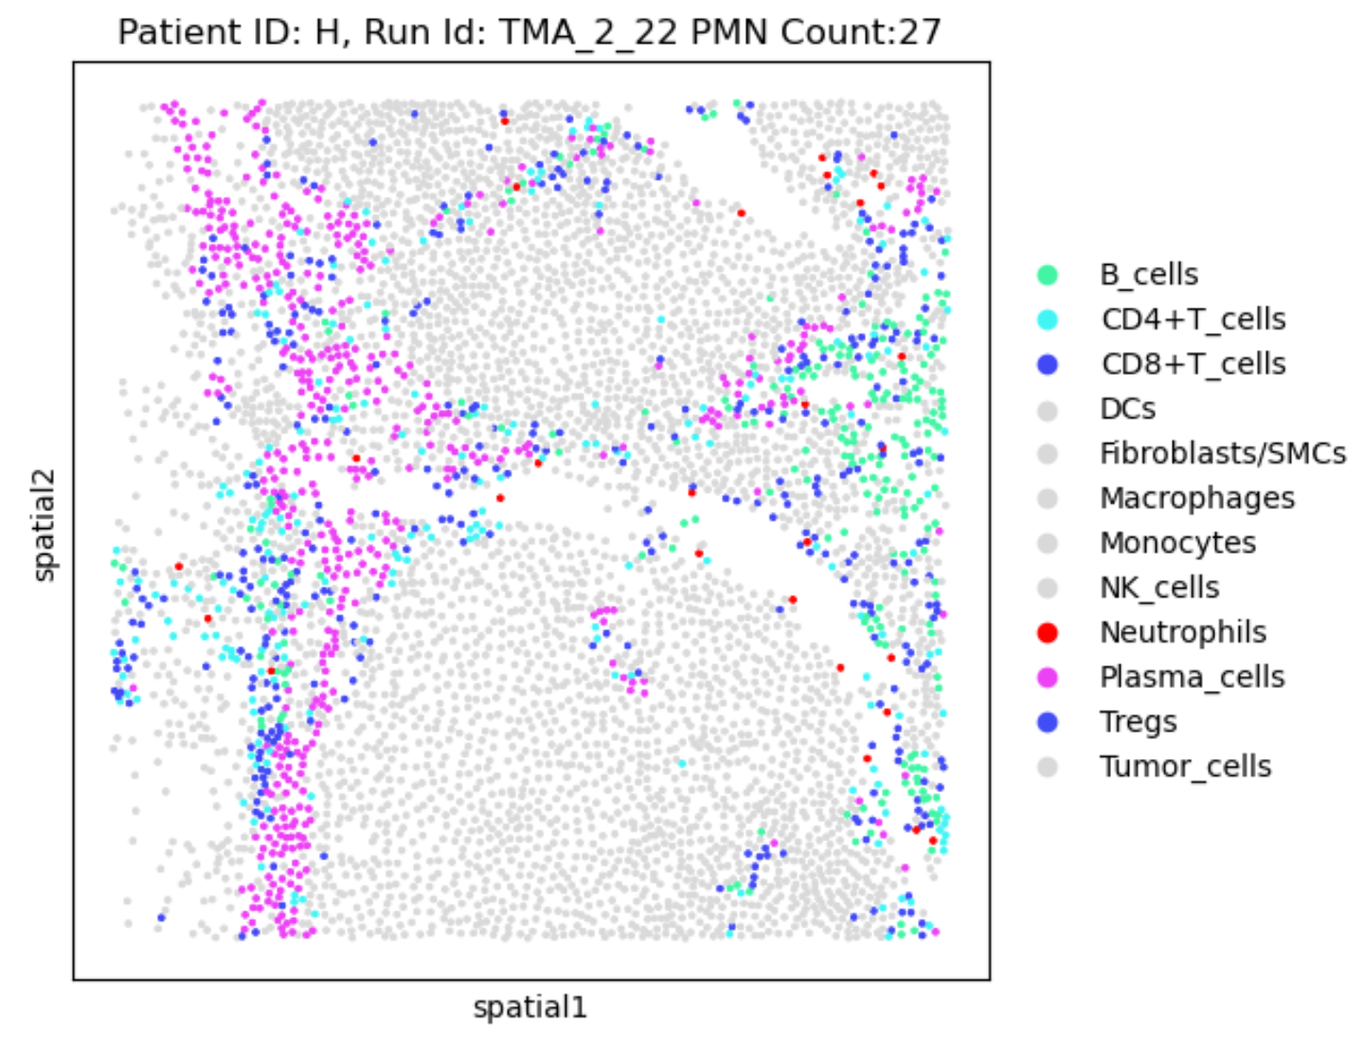
Colocalization Verification PMN-Immune interaction
Low Colocalization
High Colocalization)
* Note: Both patients were responsive to treatment

Slide 13
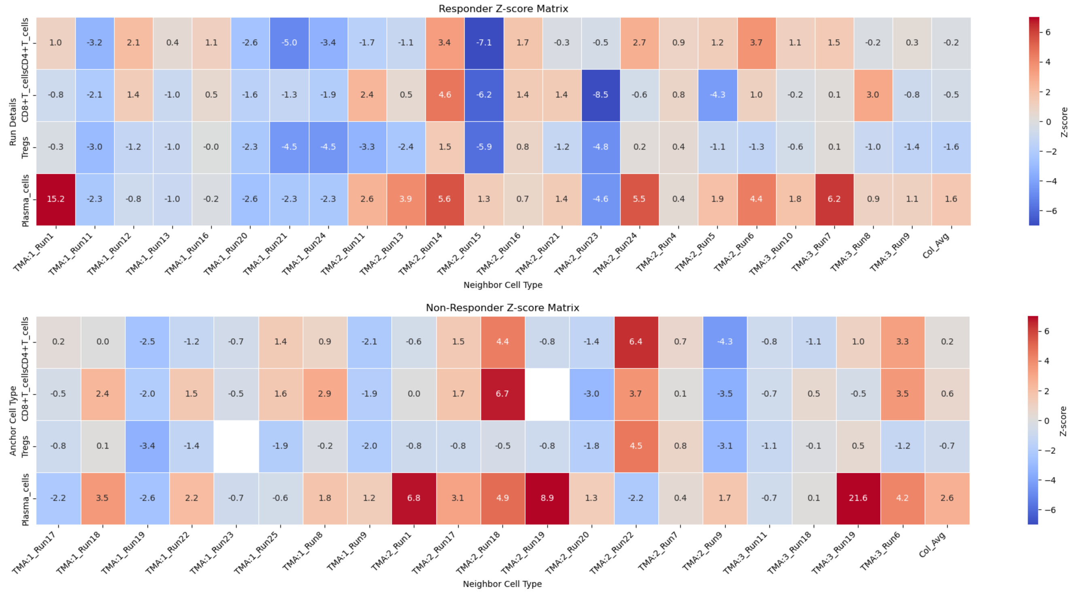
Protein Colocalization Analysis
Responder groups showed lower interaction with CD8, CD4, and Treg cells than non responders.*
Probably not statistically significant.
* Dataset limited to punches with 25+ neutrophils present

Slide 14
Current and Future Projects
Current
Colocalization Clustering Analysis of the Z-score Data
Clustering Analysis of the protein
Cleaning up and modularizing code
Other Colocalization Tests
Future:
CSF3R Gene expression in PMNs. May be useful identifier
Mapping protein data with good clustering to mRNA.

